Slide 1







Slide 2

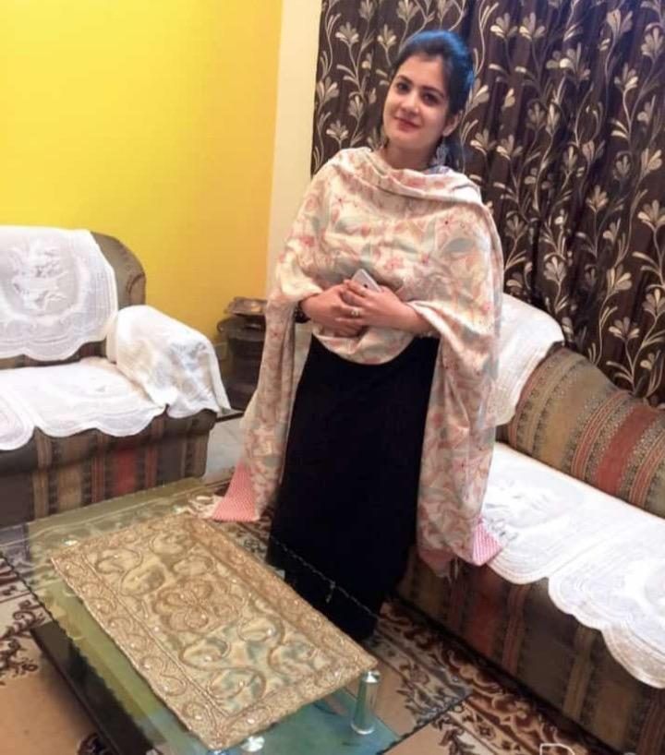




Meet the team
Khushkirat Singh Virk (1896533)
Rashmeet Kaur (1896566)
Raminderjit Singh
(1896533)
Anshul Kapoor
(1896225)
Amritpal Singh Sidhu
(1896564)
Deepak Maan
(1894830)

Slide 3
INTRODUCTION
The goal of the project to meet requirements at every level for both the Admin and the user. This application is going to help the users (restaurants) maintain the orders, the list of goods which have been ordered, delivered or have been put into a pending list.
The application aims to resolve issues of maintaining manual invoice by replacing it with automatic invoice generation which would then be send to the registered mails automatically. Special notifications would be sent to the customers regarding unauthorized login attempts or delivery updates etc.

Slide 4



IMPLEMENTATION
We have used Android Studio 3.6.3 for the coding of the application.
Java language has been used for the coding purpose.
The database used is Google Firebase.
The project has been uploaded on GitHub. The link of the repository has been shared below: https://github.com/Rashmeet14/finalproject2020.git

Slide 5

WHY FIREBASE ?
Firebase manages all data real-time in the database. So, the exchange of data to and from the database is easy and quick. Hence, if you are looking to develop mobile apps such as live streaming, chat messaging, etc., you can use Firebase.
Firebase allow syncing the real-time data across all the devices- Android, iOS, and the web without refreshing the screen.
Firebase offers integration to Google Ads, Ad Mob, DoubleClick, Play Store, Data Studio, Big Query, and Slack, to make your app development with efficient and accurate management and maintenance
Everything from databases, analytics to crashing reports are included in Firebase. So, the app development teams can stay focused on improving the user experience

Slide 6

USER TYPES
CLIENT
The client side of the application is designed for the customers who can manage their profile, add or delete products from their cart. They can even cancel a order if they want to.
ADMIN
Admin side of the application is designed for the owner who can add delete products from the categories. He has the right to cancel or accept the orders placed.

Slide 7

Functional requirements
User must signup and then login using her/his credentials.
User can order goods, see the pending received items.
Admin should be able to perform CRUD operations.
Users can see the list of purchased items in the history.
User gets notified when the admin adds a new item.
User can add delete or update the cart

Slide 8

Non functional requirements
The application should be easy to use for specific kind of users.
The application data can not be excessed without log in.
The application does not allow the access to the personal information except the client.
The admin should be able to manage the application easily without facing any difficulties.
The application should be able to work on all the versions of android.

Slide 9
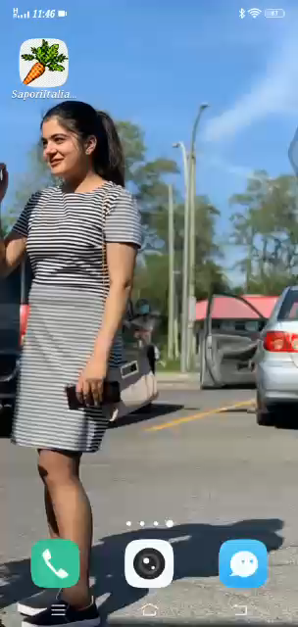
Video (Client Side)

Slide 10
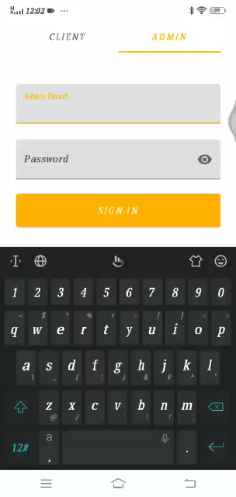
Video (Admin Side)

Slide 11

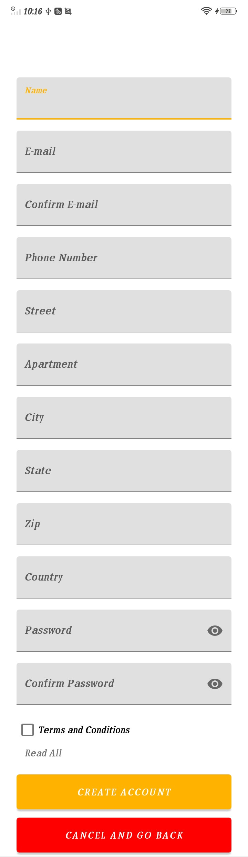
Screens explanation
Splash Screen
This is the screen which appears when the application is launched also known as startup screen and shows when the application is loading.
Sign Up Screen
This screen is for the new users. The application requires the user to sign up with the credentials such as Name, Email, Phone number, Address, Password etc. The terms and conditions of the application must be accepted before signing up .

Slide 12
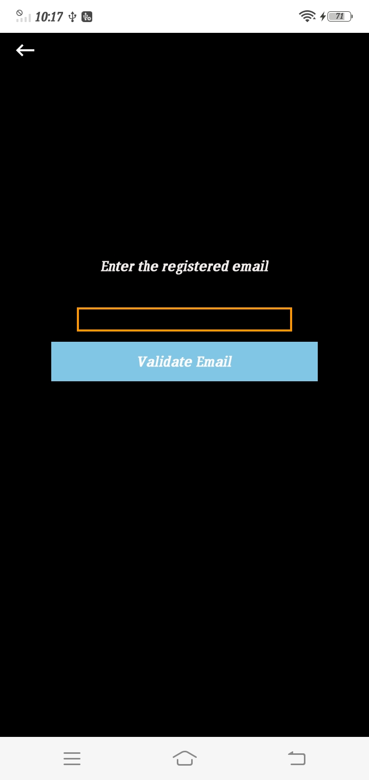
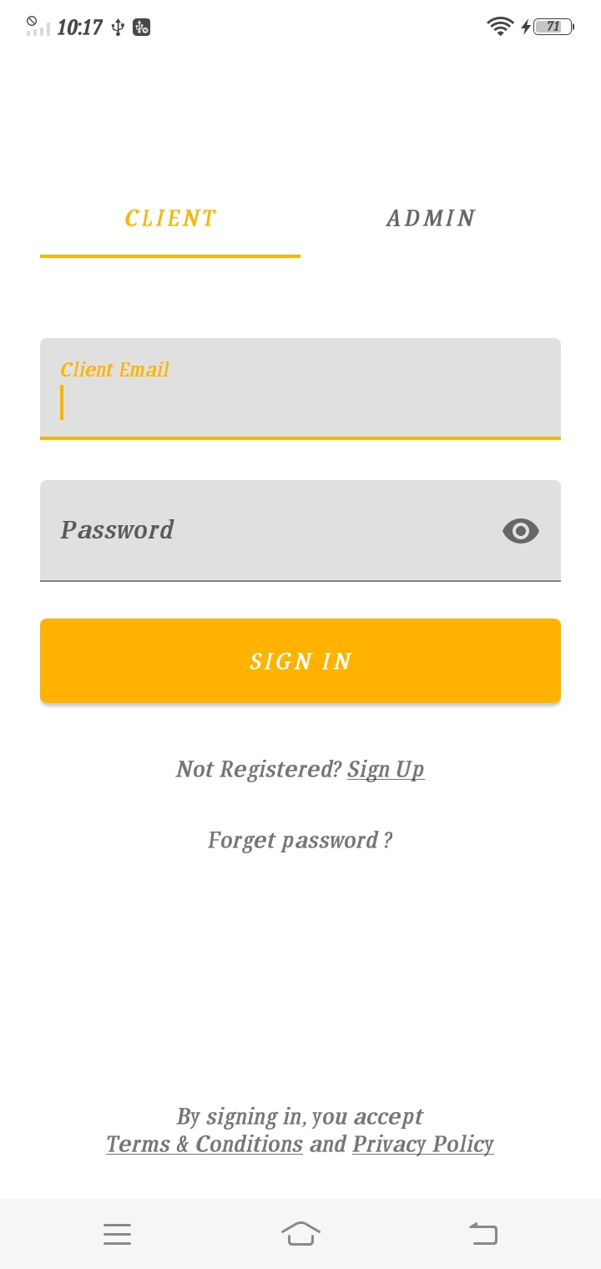
Reset Password
This screen is for the users who are already registered with their email to reset their password in case they forget their password for logging in.
Sign in Screen(Client)
This screen is for the client side that means the admin can not log in from this side of the screen. Even if he enters his credentials on the client side, he will be notified that he has to log in from the admin side. This side is only meant to be for the registered users.

Slide 13
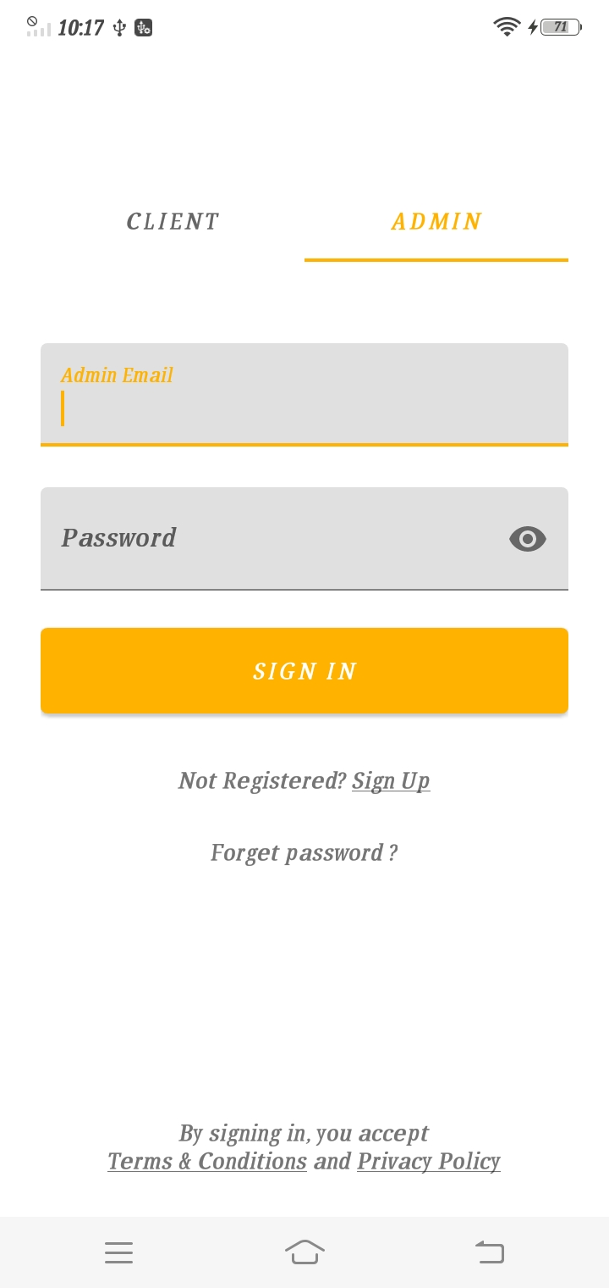
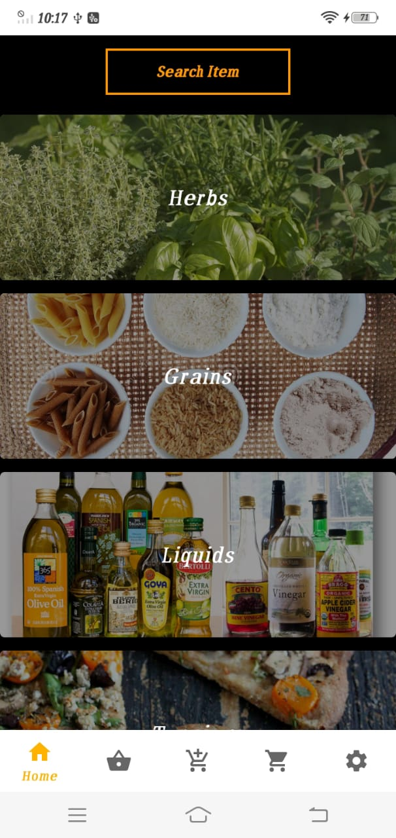
Home Screen(Client)
This is the home screen for user side with a dark theme. A client can scroll for various categories displayed on the home screen and open any category and look for various ingredients present in the different categories.
Sign In (Admin side)
This screen is used for admin login. A client cannot login from this side of the application. It will inform the client by showing a toast that this side is meant for the admin login and not the user.

Slide 14
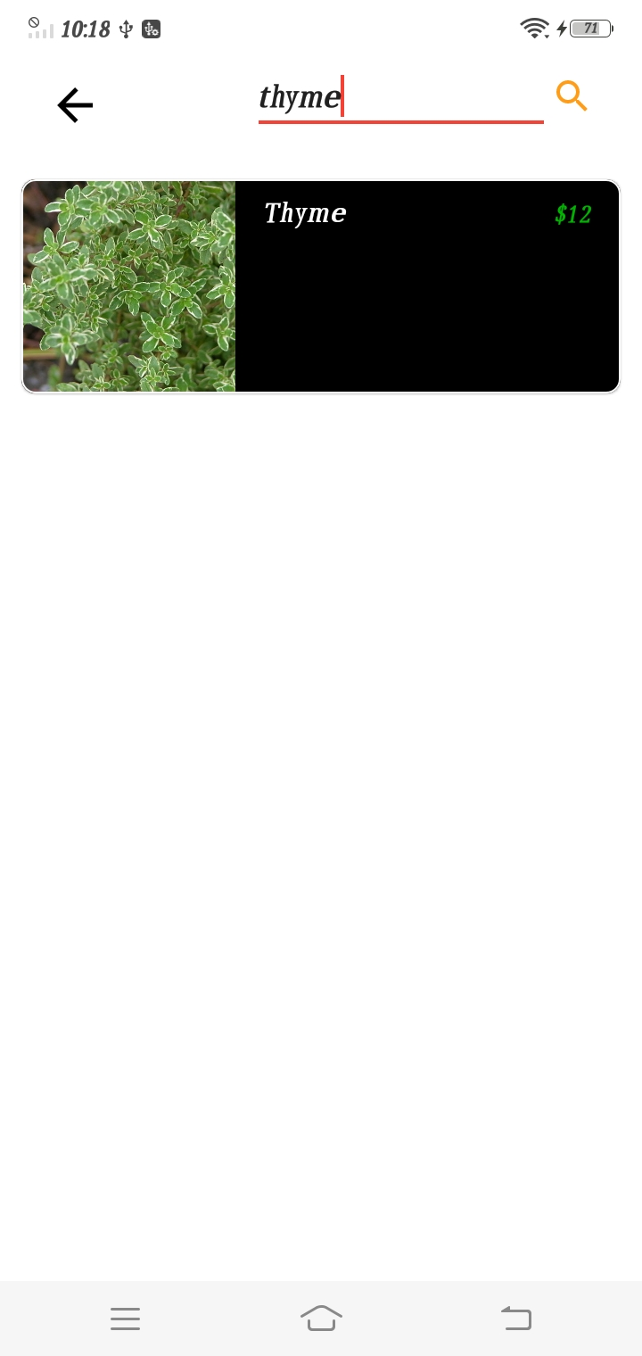
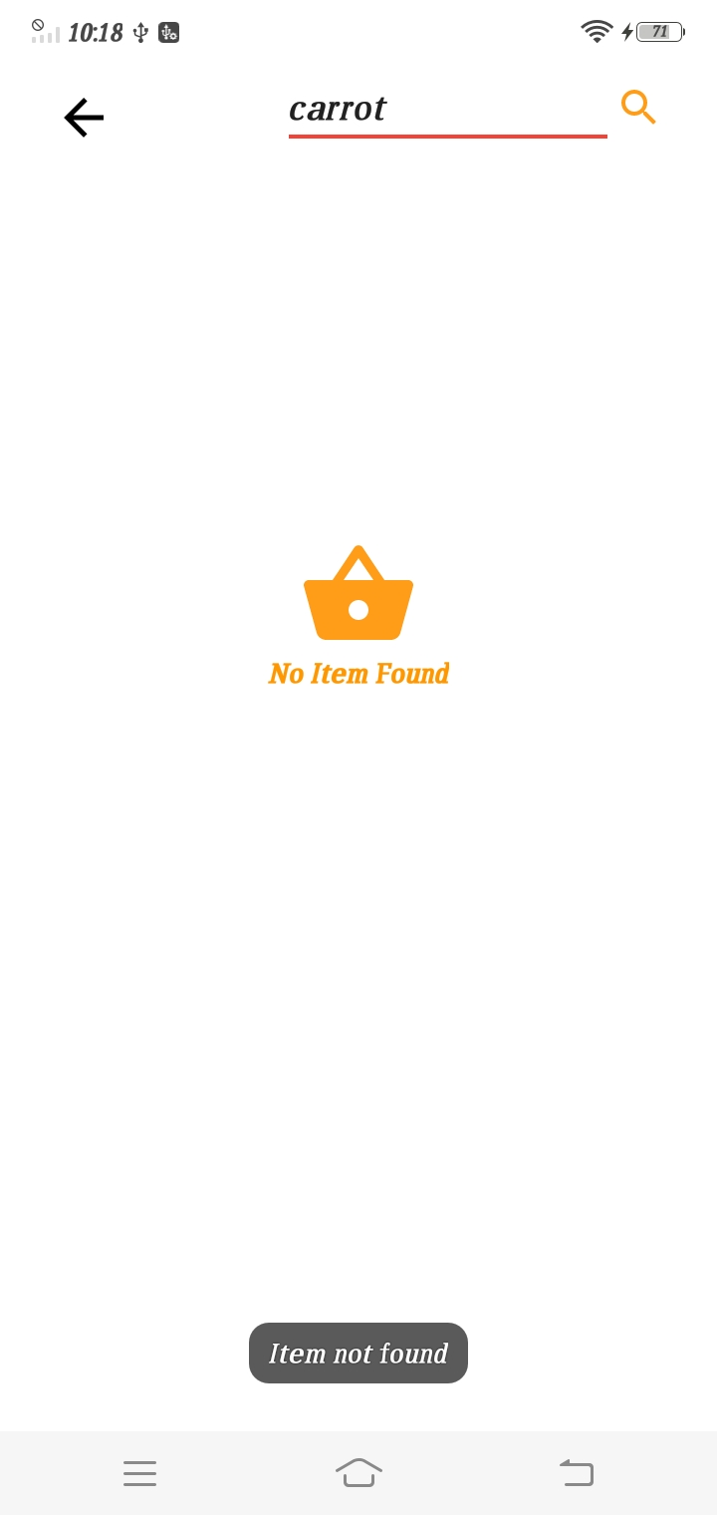
Search(Existing Item)
This screen is for the new users. The application requires the user to sign up with the credentials such as Name, Email, Phone number, Address, Password etc. The terms and conditions of the application must be accepted before signing up .
Search(Non-existing item)
This screen is for the new users. The application requires the user to sign up with the credentials such as Name, Email, Phone number, Address, Password etc. The terms and conditions of the application must be accepted before signing up .

Slide 15
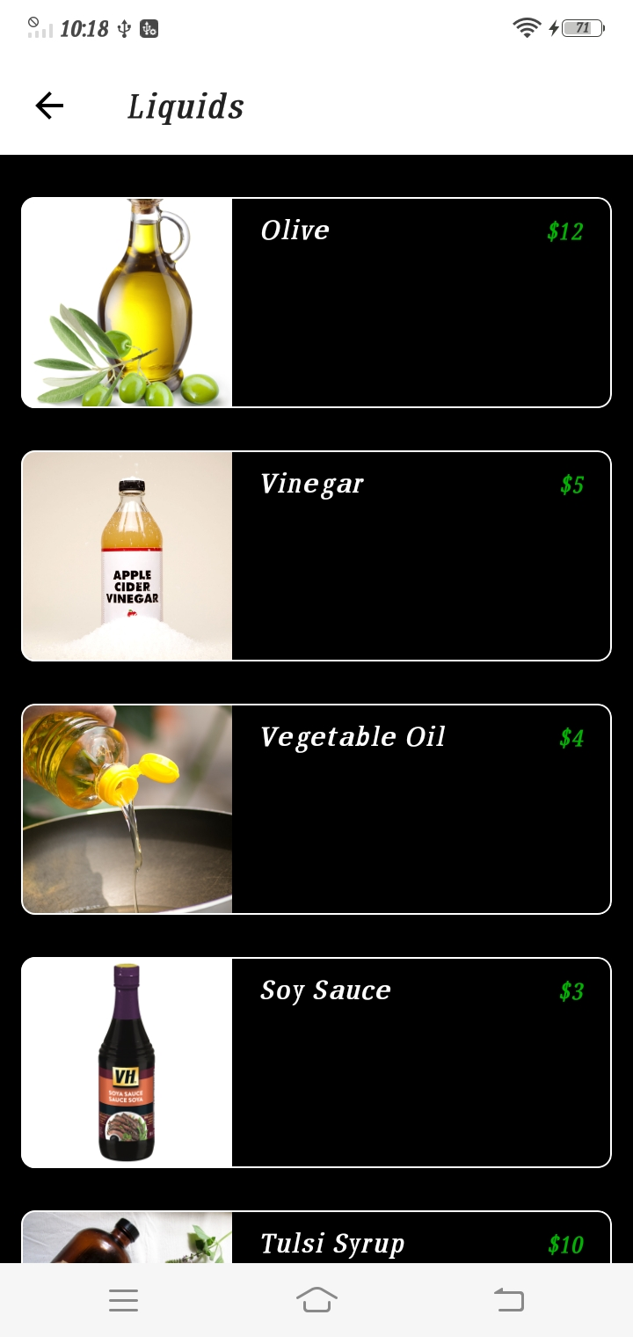
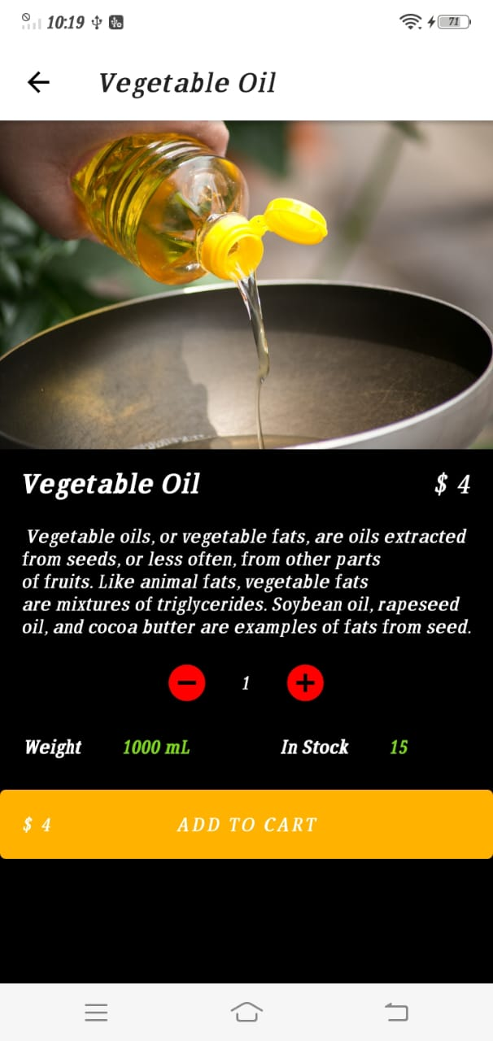
Category Items
The category items will be shown like this. A user can have a look at all the items available and the select any one to check the description weight and price for the product. User can add maximum 10 products to the cart.
Item
This screen displays the detailed description of the product along with the weight and price of the item. A customer can also have a look at the items left in the stock and check whether the stock satisfy their need or not.

Slide 16
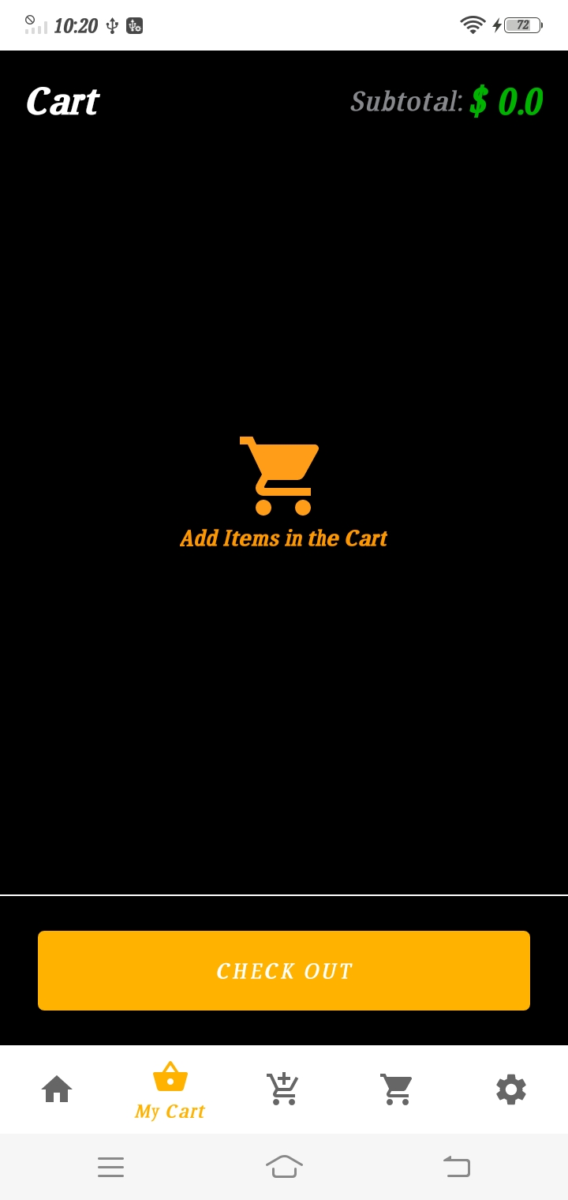
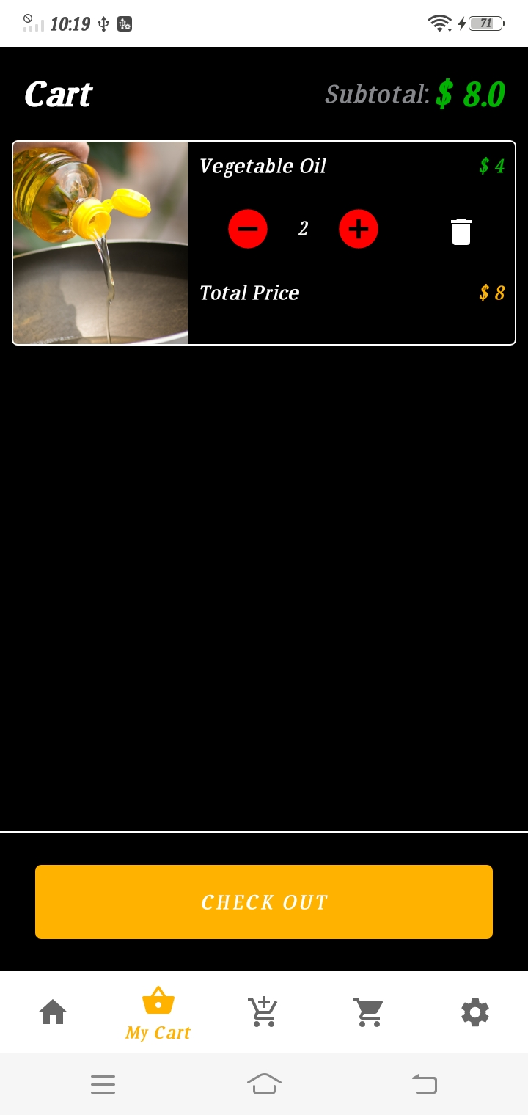
Cart(Empty)
This is the empty screen for a cart which has no products added to it. Once the user adds the product the view of this screen changes to the one as shown in the next image.
Cart (after adding item)
This screen of the cart shows that a product has been added to the cart. A user can delete the product from the cart or increase and decrease the quantity. As the user changes the quantity the subtotal of the cart changes aswell.

Slide 17
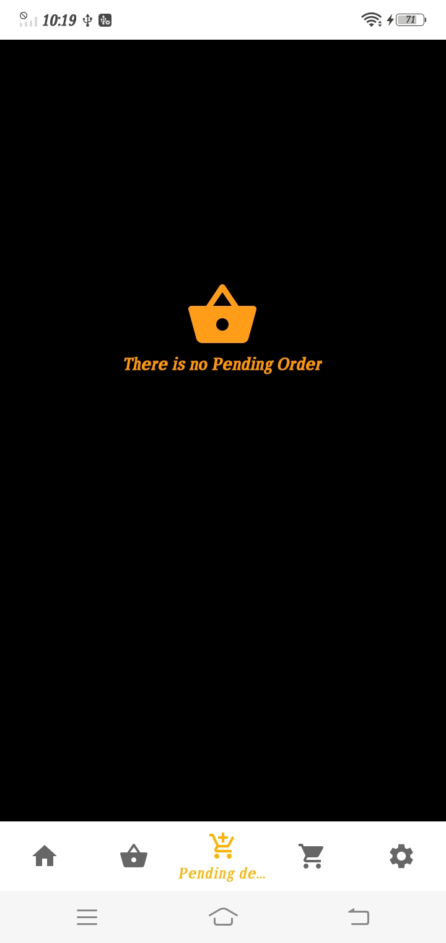
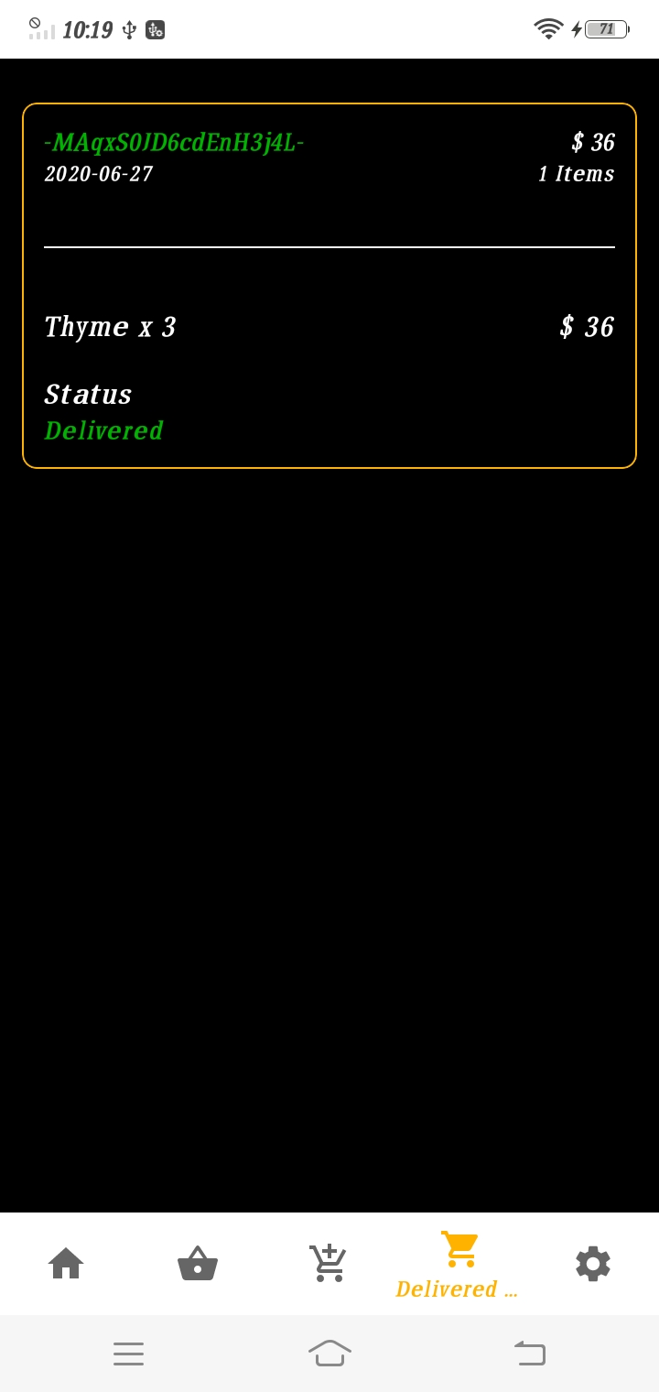
Pending Orders
This screen shows the product list which has still not been accepted by the admin or the order which has been rejected by the admin. User can delete the product from this screen if it has been declined by the admin.
Delivered Orders
This screen shows the orders which have been accepted and have been delivered at the registered address of the user. This will show the date of the order, the items that were ordered and the order id along with the total price of the order.

Slide 18
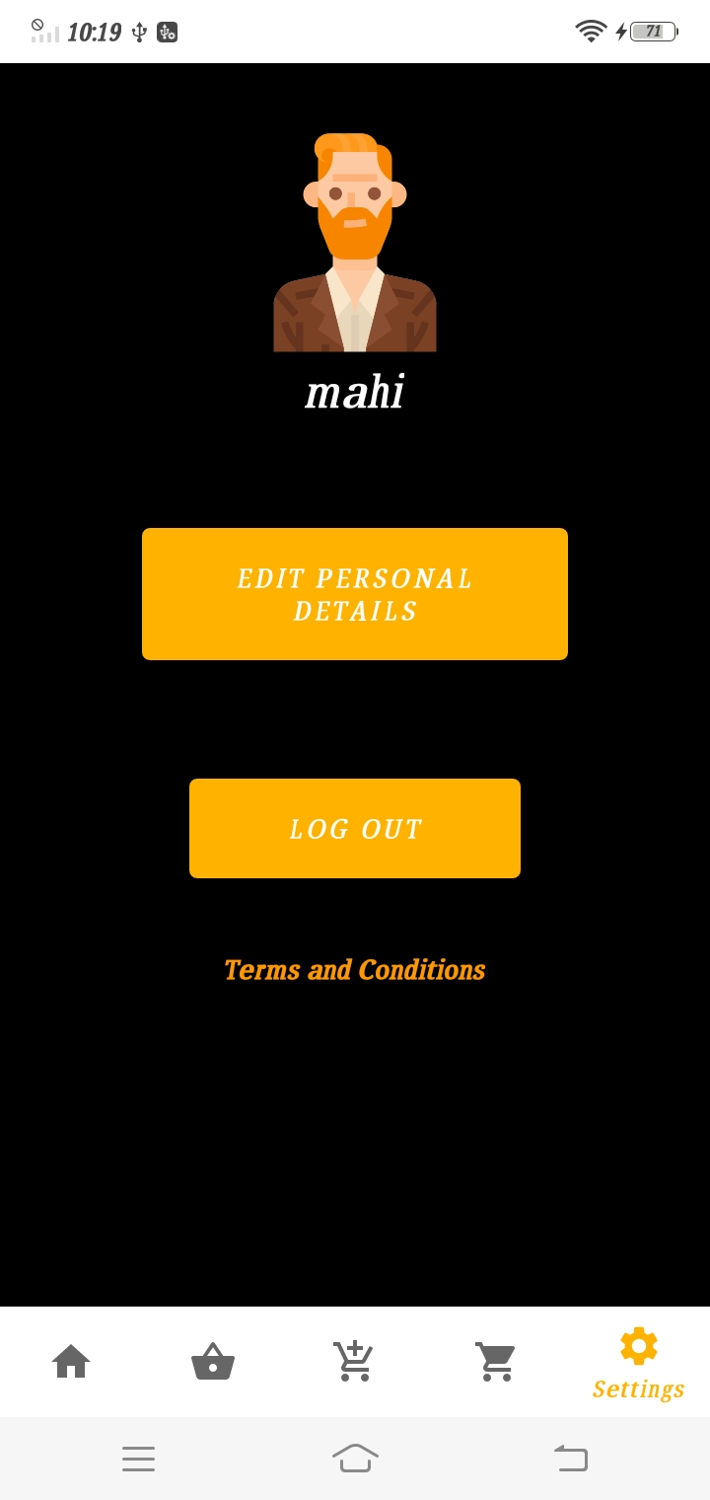
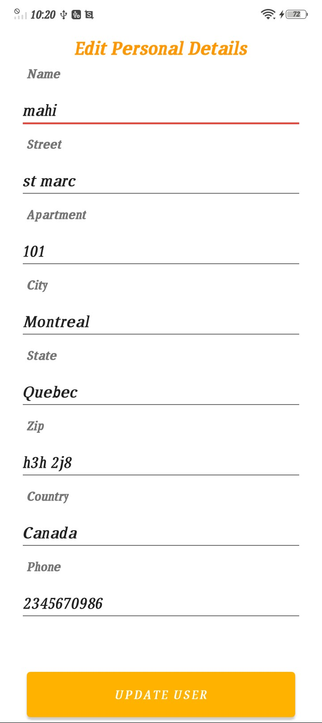
Settings
This screen shows the name of the user. It has the edit personal details button that takes the user to another screen(next screen) , log out button which allows the user to go out from their account on th sign in screen again and the terms and conditions section in case the user didn’t read them on sign up.
Edit Personal Details
This screen allows the users to edit the personal information they entered on sign up. User can update their phone number, name, address in this section of the application.

Slide 19
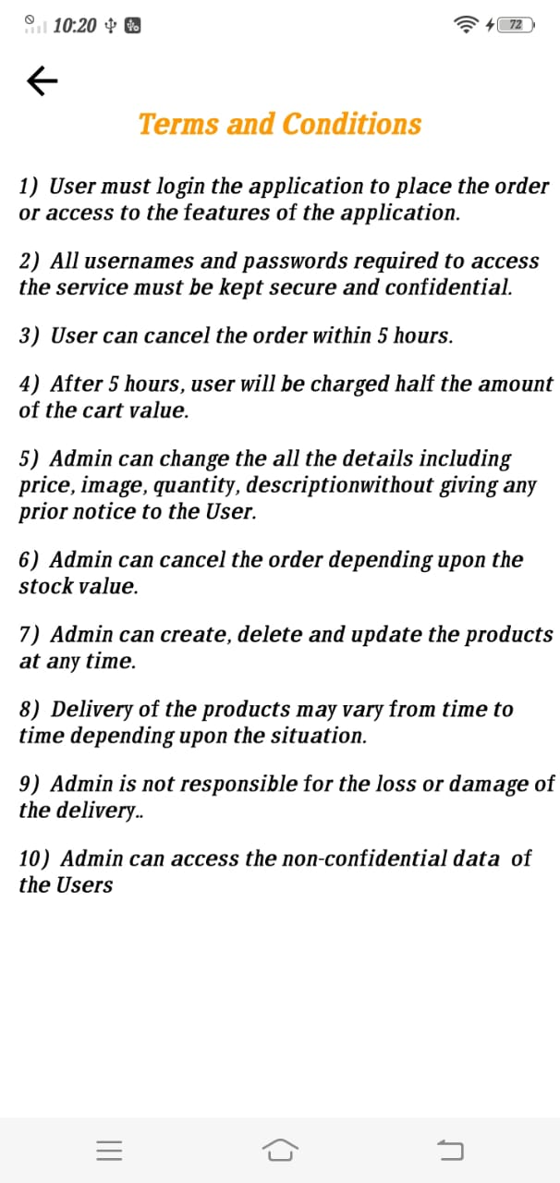
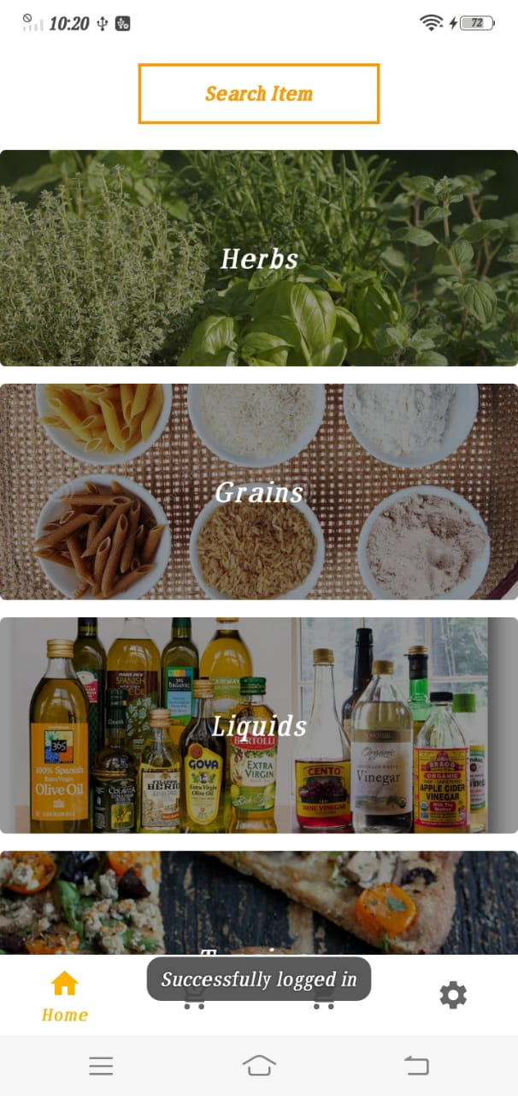
Terms and Conditions
This screen shows the terms and conditions which will help the user to understand the application policy really well.
Home Screen(Admin)
This screen is shows the admin home screen with a light theme different from the client side. The user can only view the items and order them but the admin can add new items to different categories or delete existing items.

Slide 20
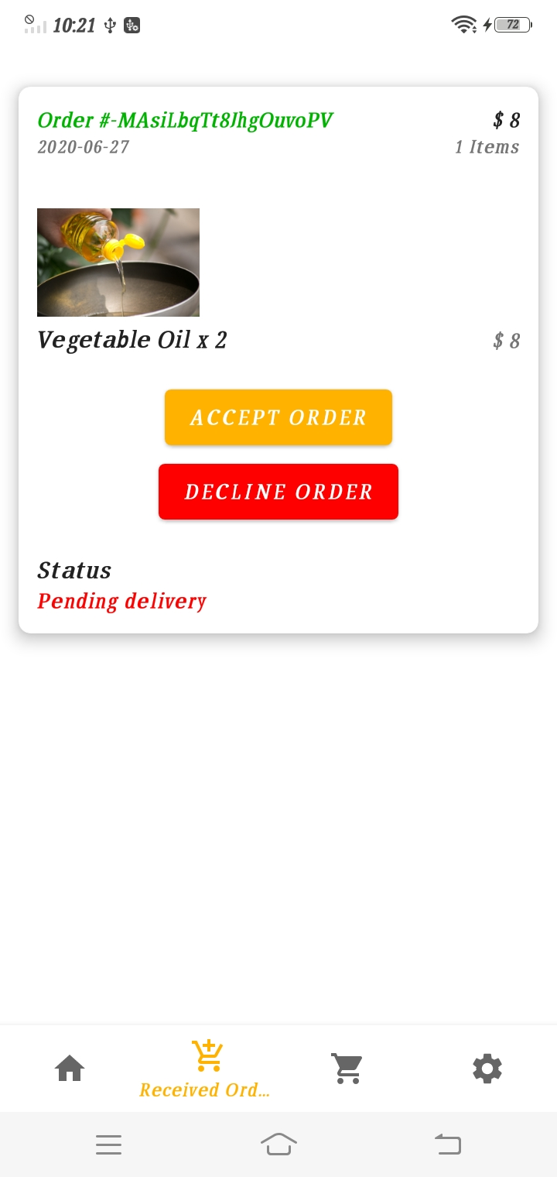
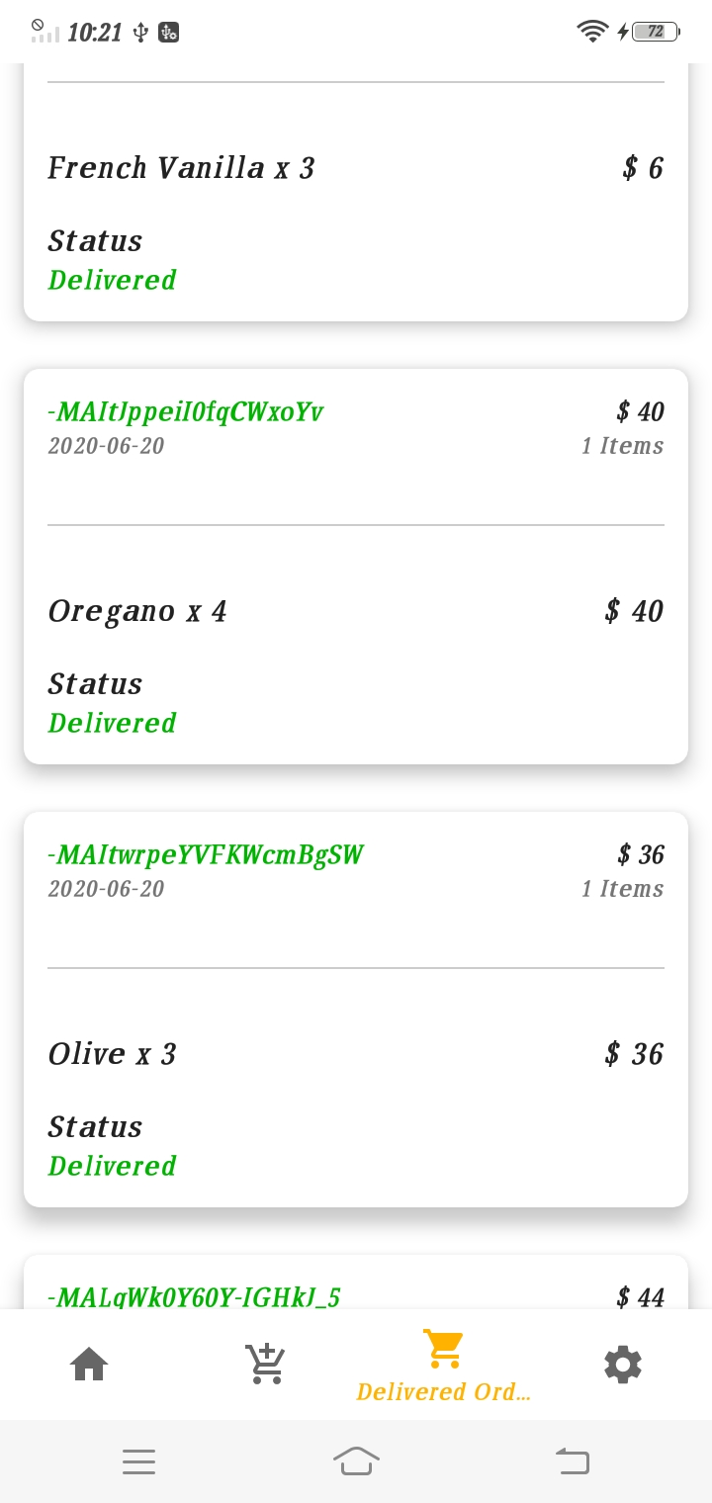
Received Orders
This screen shows the orders that the admin has received from the clients. This screen will shows two buttons that allow the admin to either accept or decline the order. The accepted orders will go to the delivered order screen and the declined will be deleted automatically.
Delivered Orders
This screen shows the history of orders that the admin had accepted and they have been delivered. It shows the details of the orders along with id of the order, the quantity and the price.

Slide 21
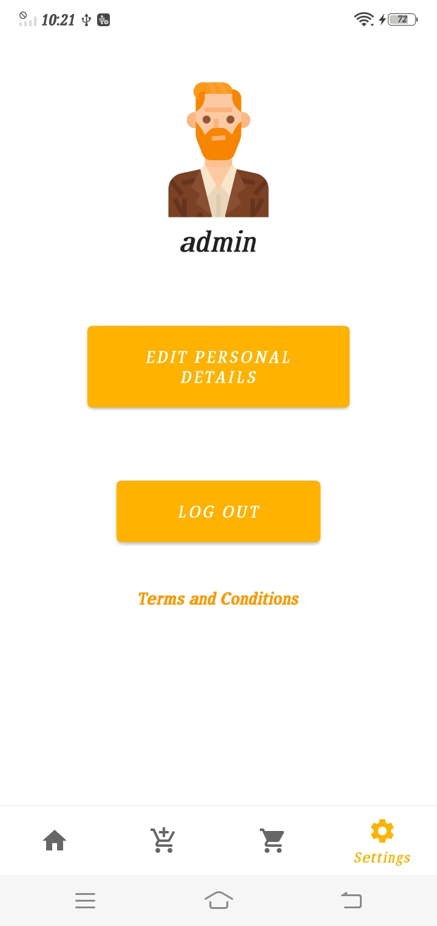
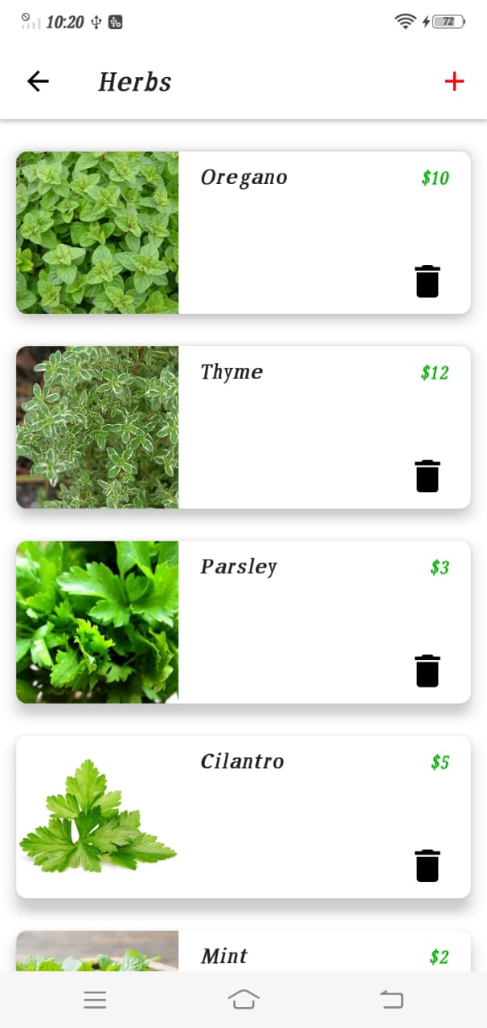
Settings
This screen is similar to the user side where the admin can edit his personal details, logout from the application and read the terms and conditions.
Category data
This screen shows category data for the admin side. This screen contains a add icon which allows the admin to add new item. The admin can delete the existing item using the delete icon.

Slide 22
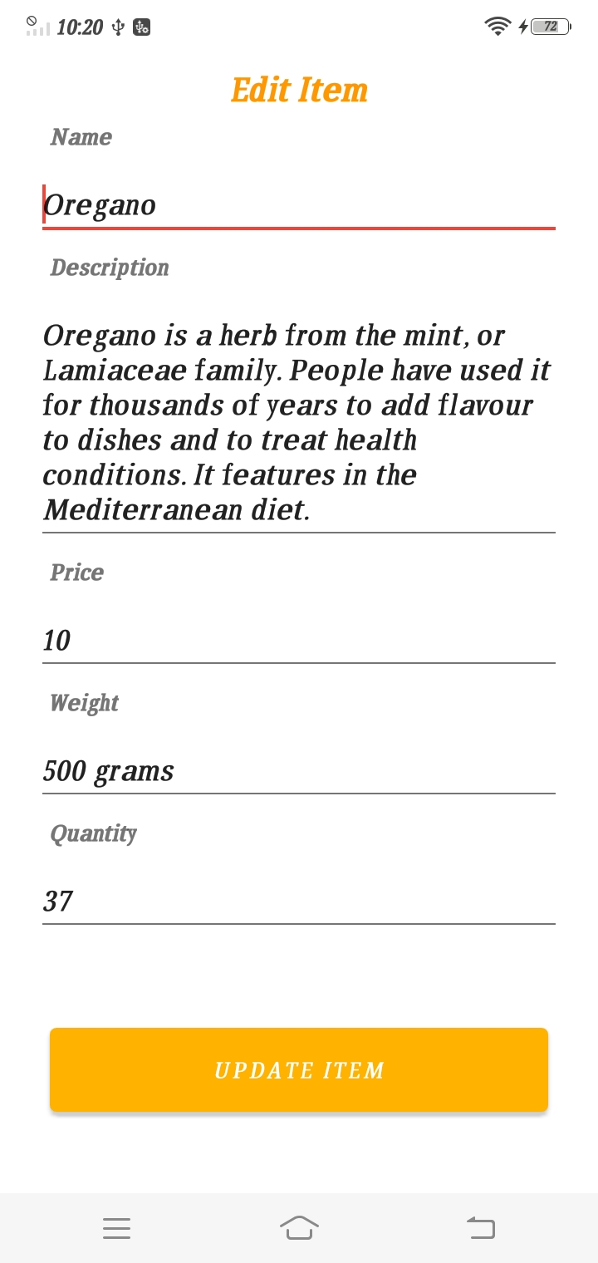
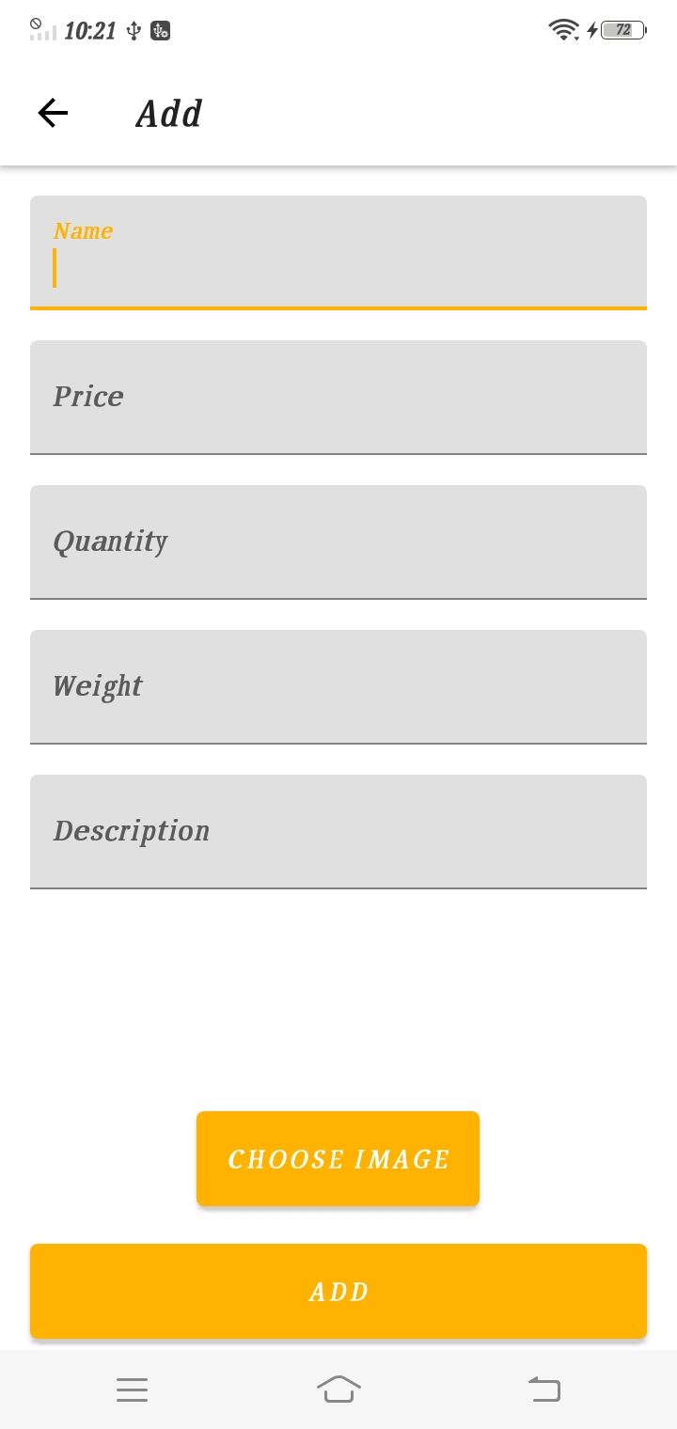
Editing Items
This screen allows the admin to edit the information for the items available. He can change the price weight of the item. He can increase or decrease the quantity.
Adding new item
This screen allows the admin to add new items to the categories along with the detailed description. Admin can choose an image for the display of the item.

Slide 23
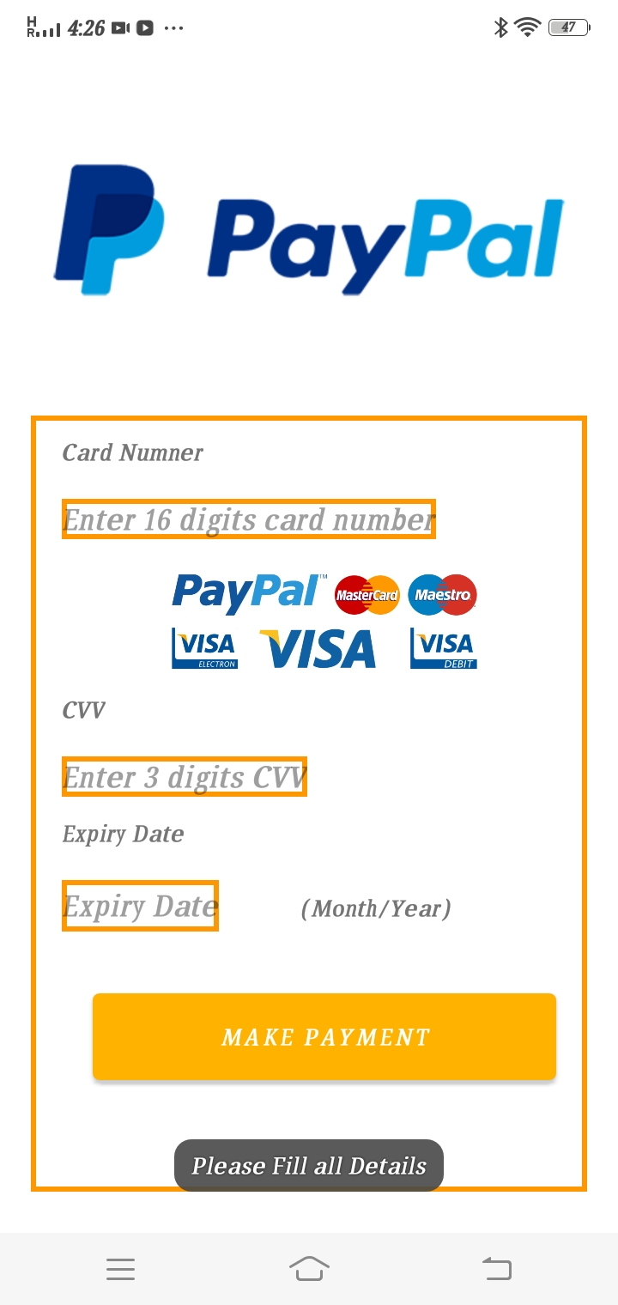
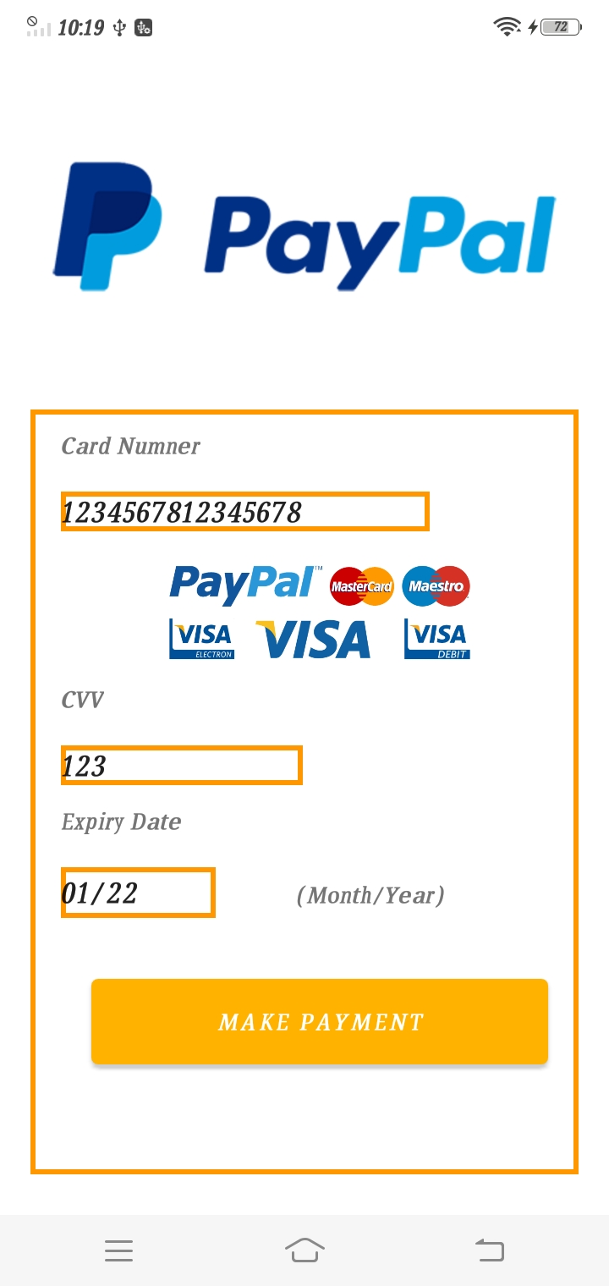
Special Features
Payment Screen
This screen is displayed after the user check out with the items in the cart. This is not an original payment gateway but is designed to show the future scope of the application.
Payement Details
This screen is not the original payment gateway as stated but still a user won’t be able to click the make payment and go to the next screen without entering fake details but with the proper constraints applied on the date, cvv and card number.

Slide 24
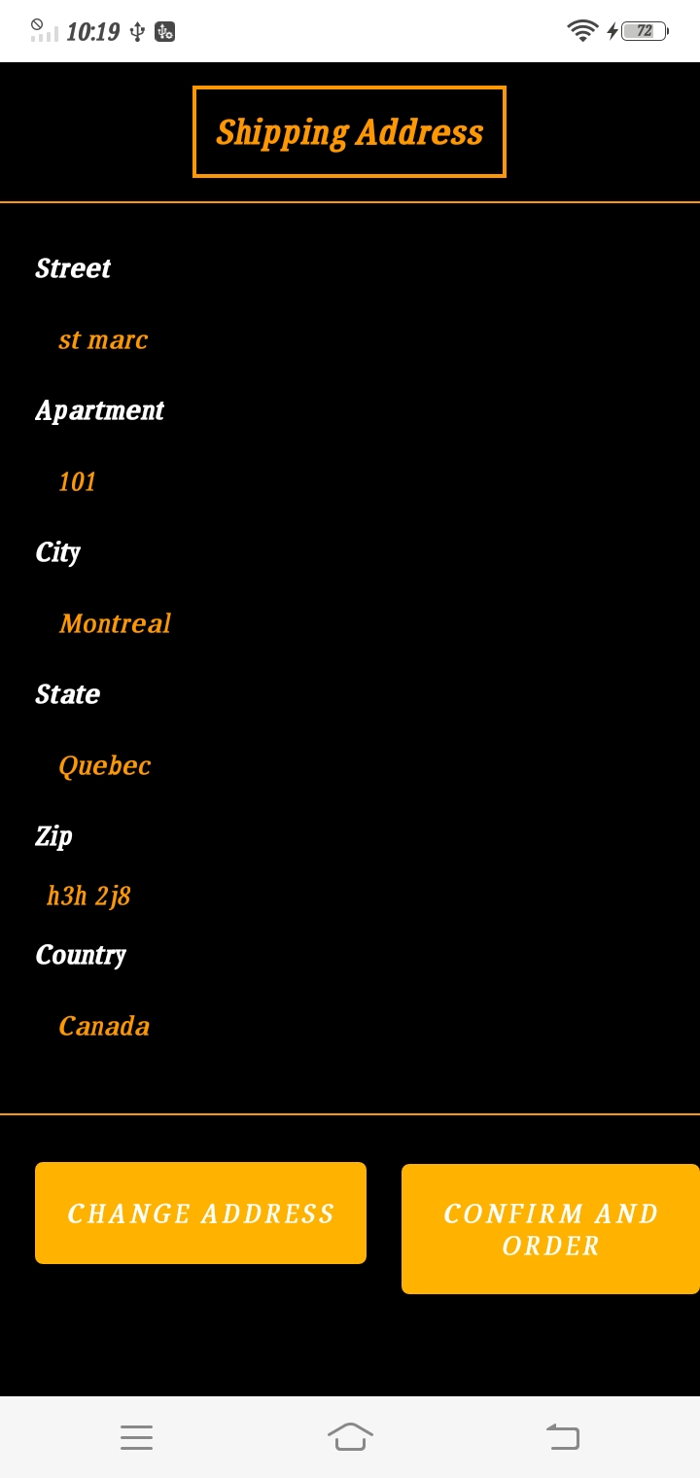
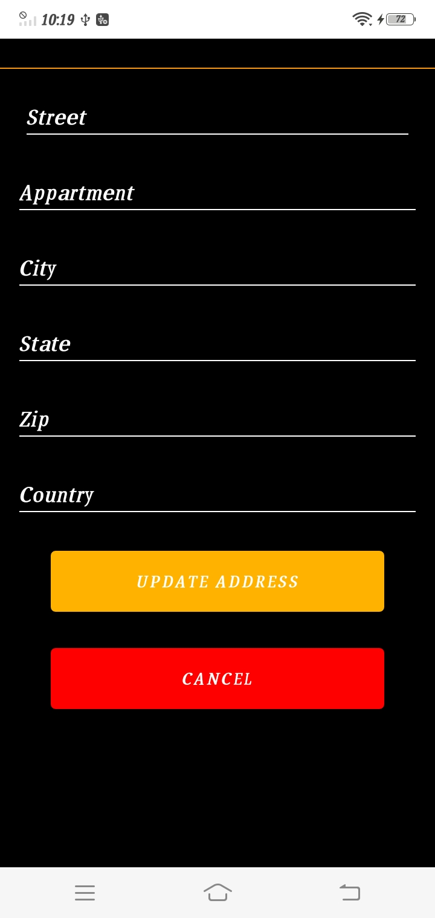
Shipping Address
This screen shows up after clicking on Check out. It confirms from the user that the delivery address should be the one they entered at signup or they want to update a new one. This screen shows up before the user makes the payment.
Change Address
This is the screen which opens when the user clicks on the change address option in the previous screen. If the user clicken on the change address they can click on cancel and go back to the previous screen or if they want to update the address they canm enter the new details and click on the update address button.

Slide 25
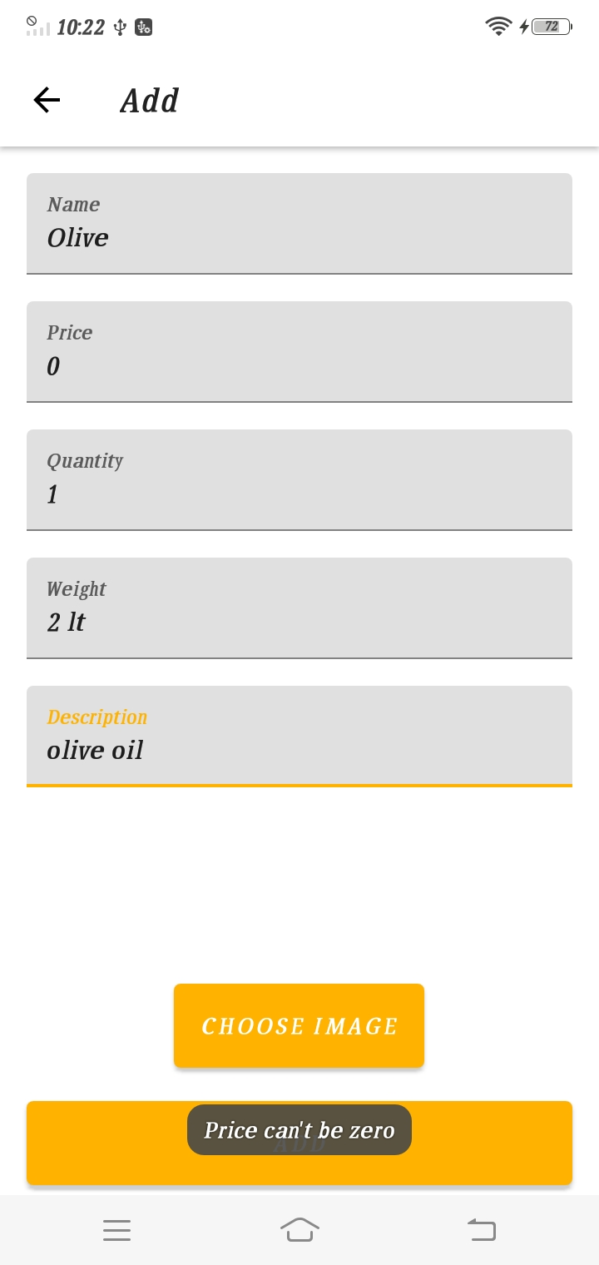
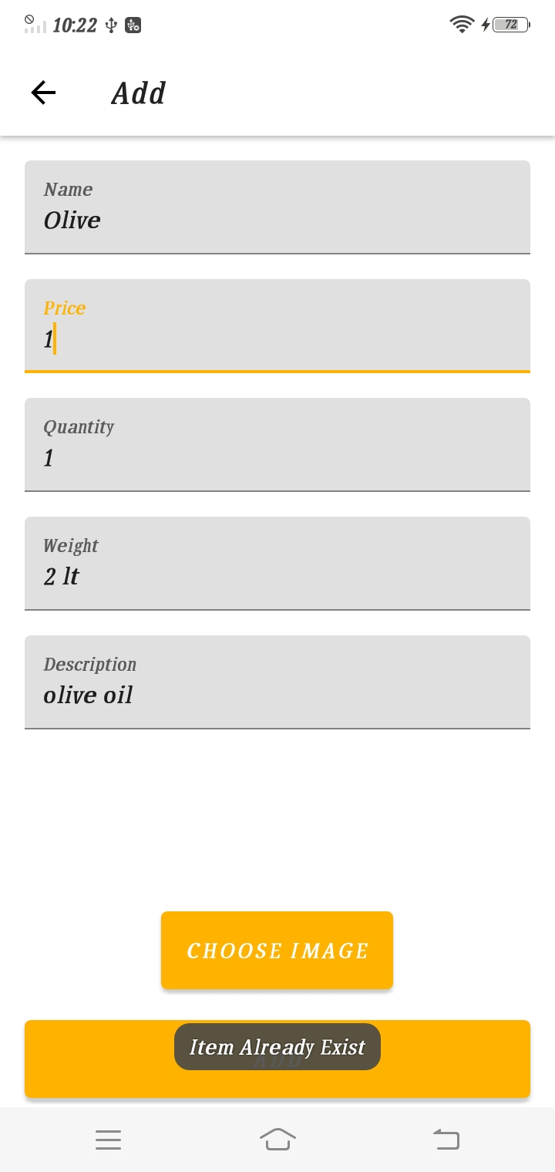
Add New Item
This screen is for the admin when he wants to add a new product. This screen contains the price section. The admin can not enter the price as zero if he does, once he clicks on add a toast will be displayed that the price can’t be zero.
Add New Item
This is also the add new product screen but the difference here is that an item named Olive already exists. The admin cannot add items with same name. He will be informed that item already exists. This reduces the probability of making mistake of adding same product again.

Slide 26
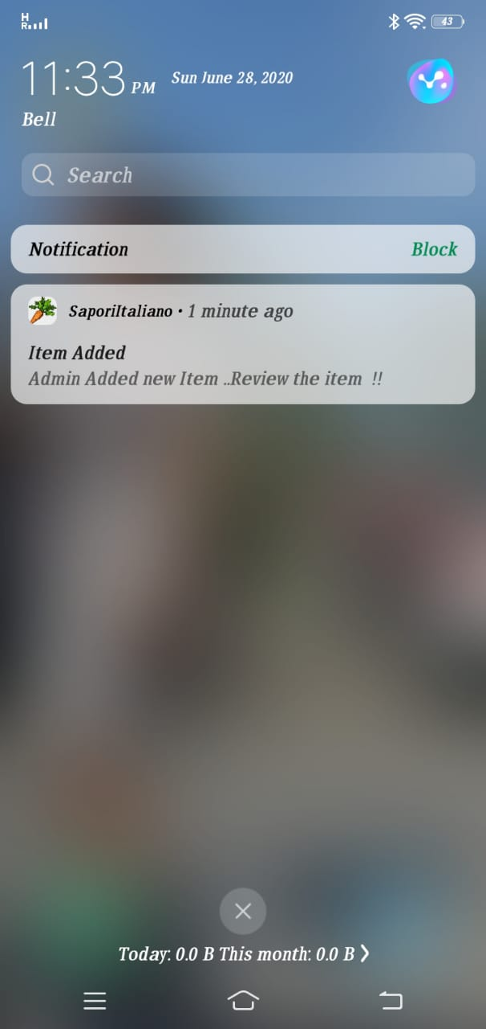
Notification
When the admin adds a new item the user will be informed by a push notification. The notification will be displayed as shown in the picture.

Slide 27
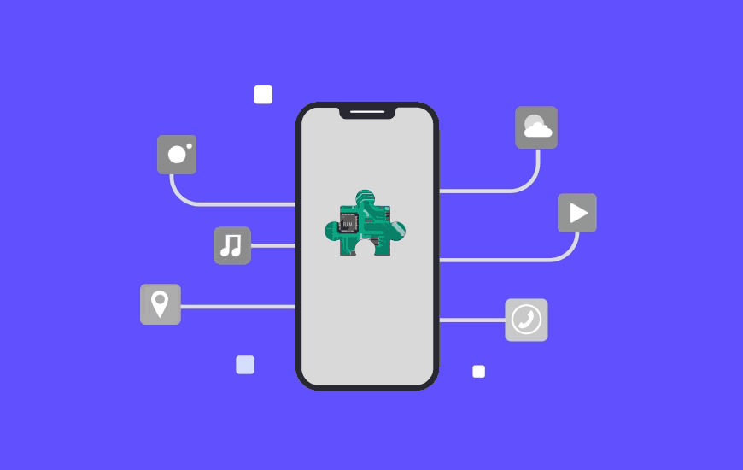
Future Scope
We can integrate the application with google API (location based).
The payment gateway will be implemented to generate real time payments.
We can use real time server instead of firebase.

Slide 28
COMPLEX PARTS
Hosting the external node application on firebase
Search button iteration from all the items.
Cart complexity for deleting updating, total sum and reflecting that in the database.
One file shows two views by updating the address.

Slide 29


